Slide 1

IOT Project
Name: Meshal Fahad Almubarak & Abdulrahman Alshwerakh

Slide 2
Defined the Problem
time
line
Crowded
cost

Slide 3
Steps to solve problem
Determine the problem.
Determine the objective.
Select the method.
Select the Components will use.

Slide 4
Components
Smart
phone
Router
Door
Reader
Trip Sensor
Wireless LAN Control
Camera
ID Card
SBC
Motion sensor
Access Point
Speaker
Laptop
Switch
Home getaway
Multi Switch
Alarm

Slide 5
Final diagram
Security gate
Passport gate
Plane gate

Slide 6
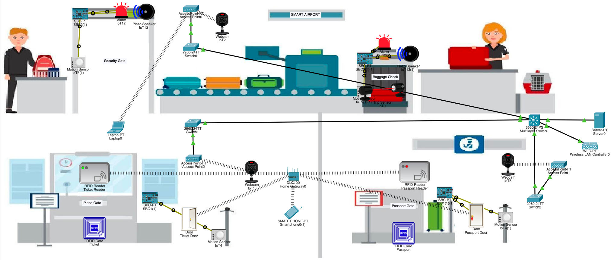
Result

Slide 7
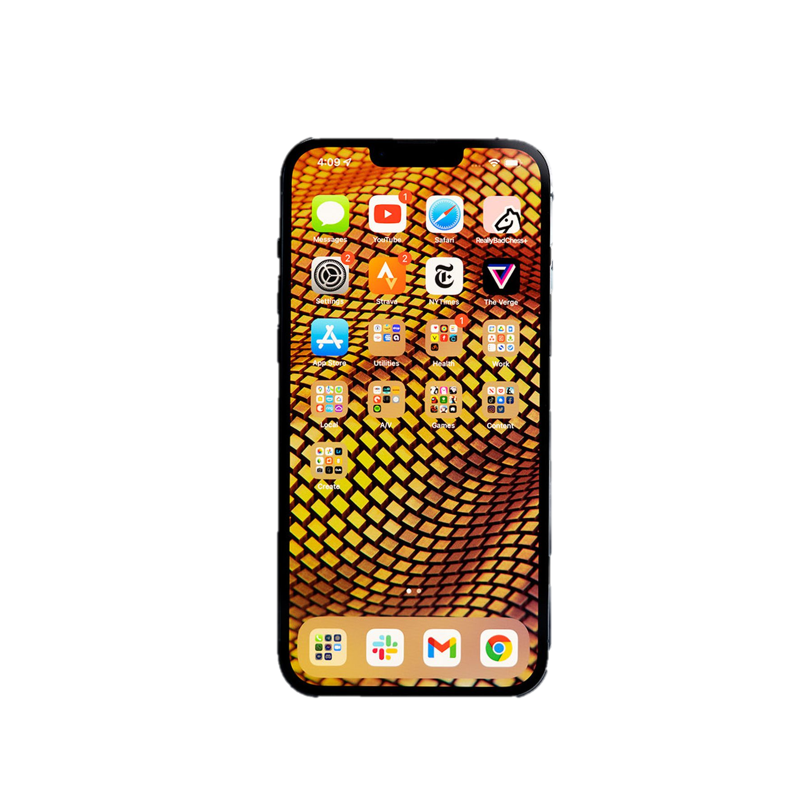
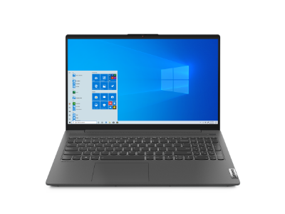
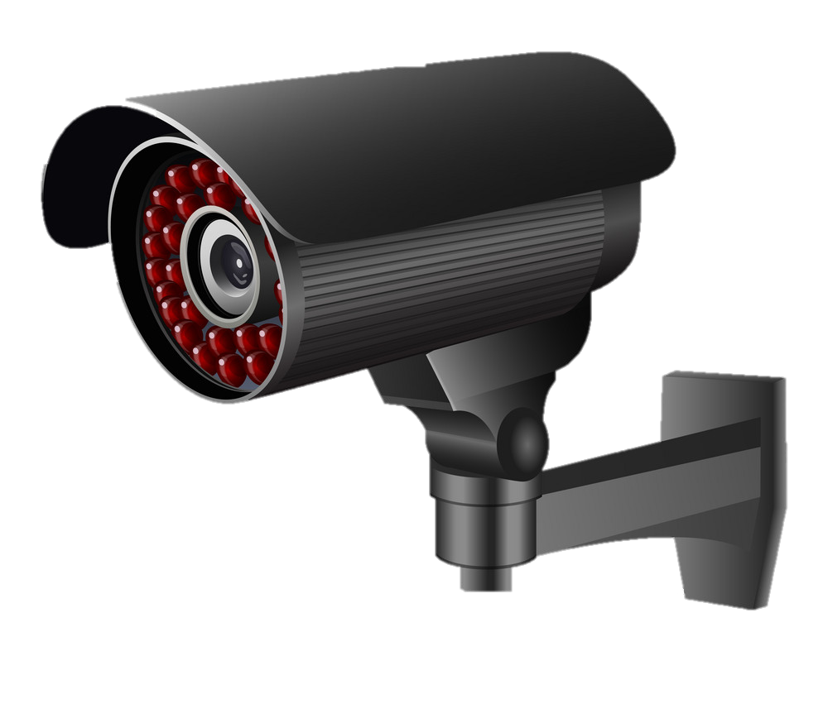
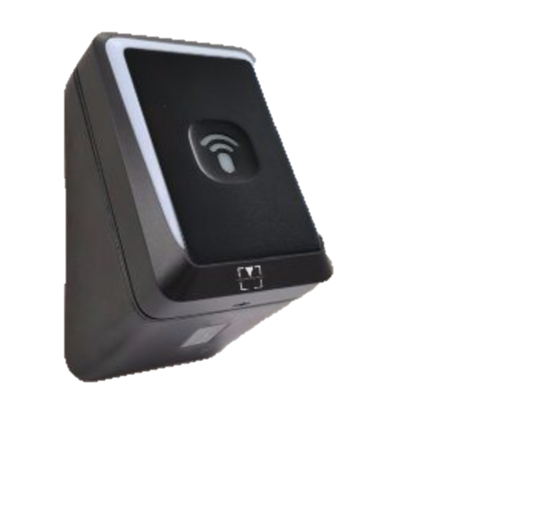
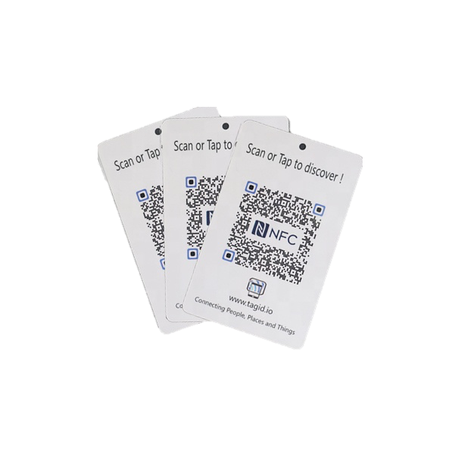
End points

Slide 8
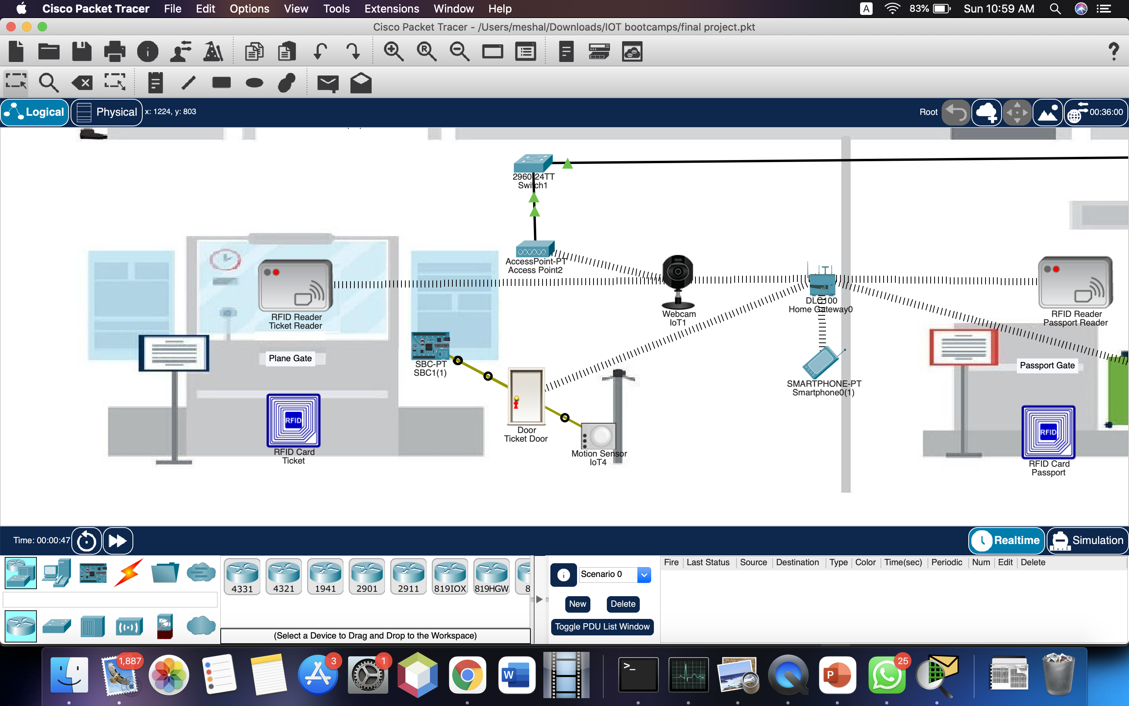
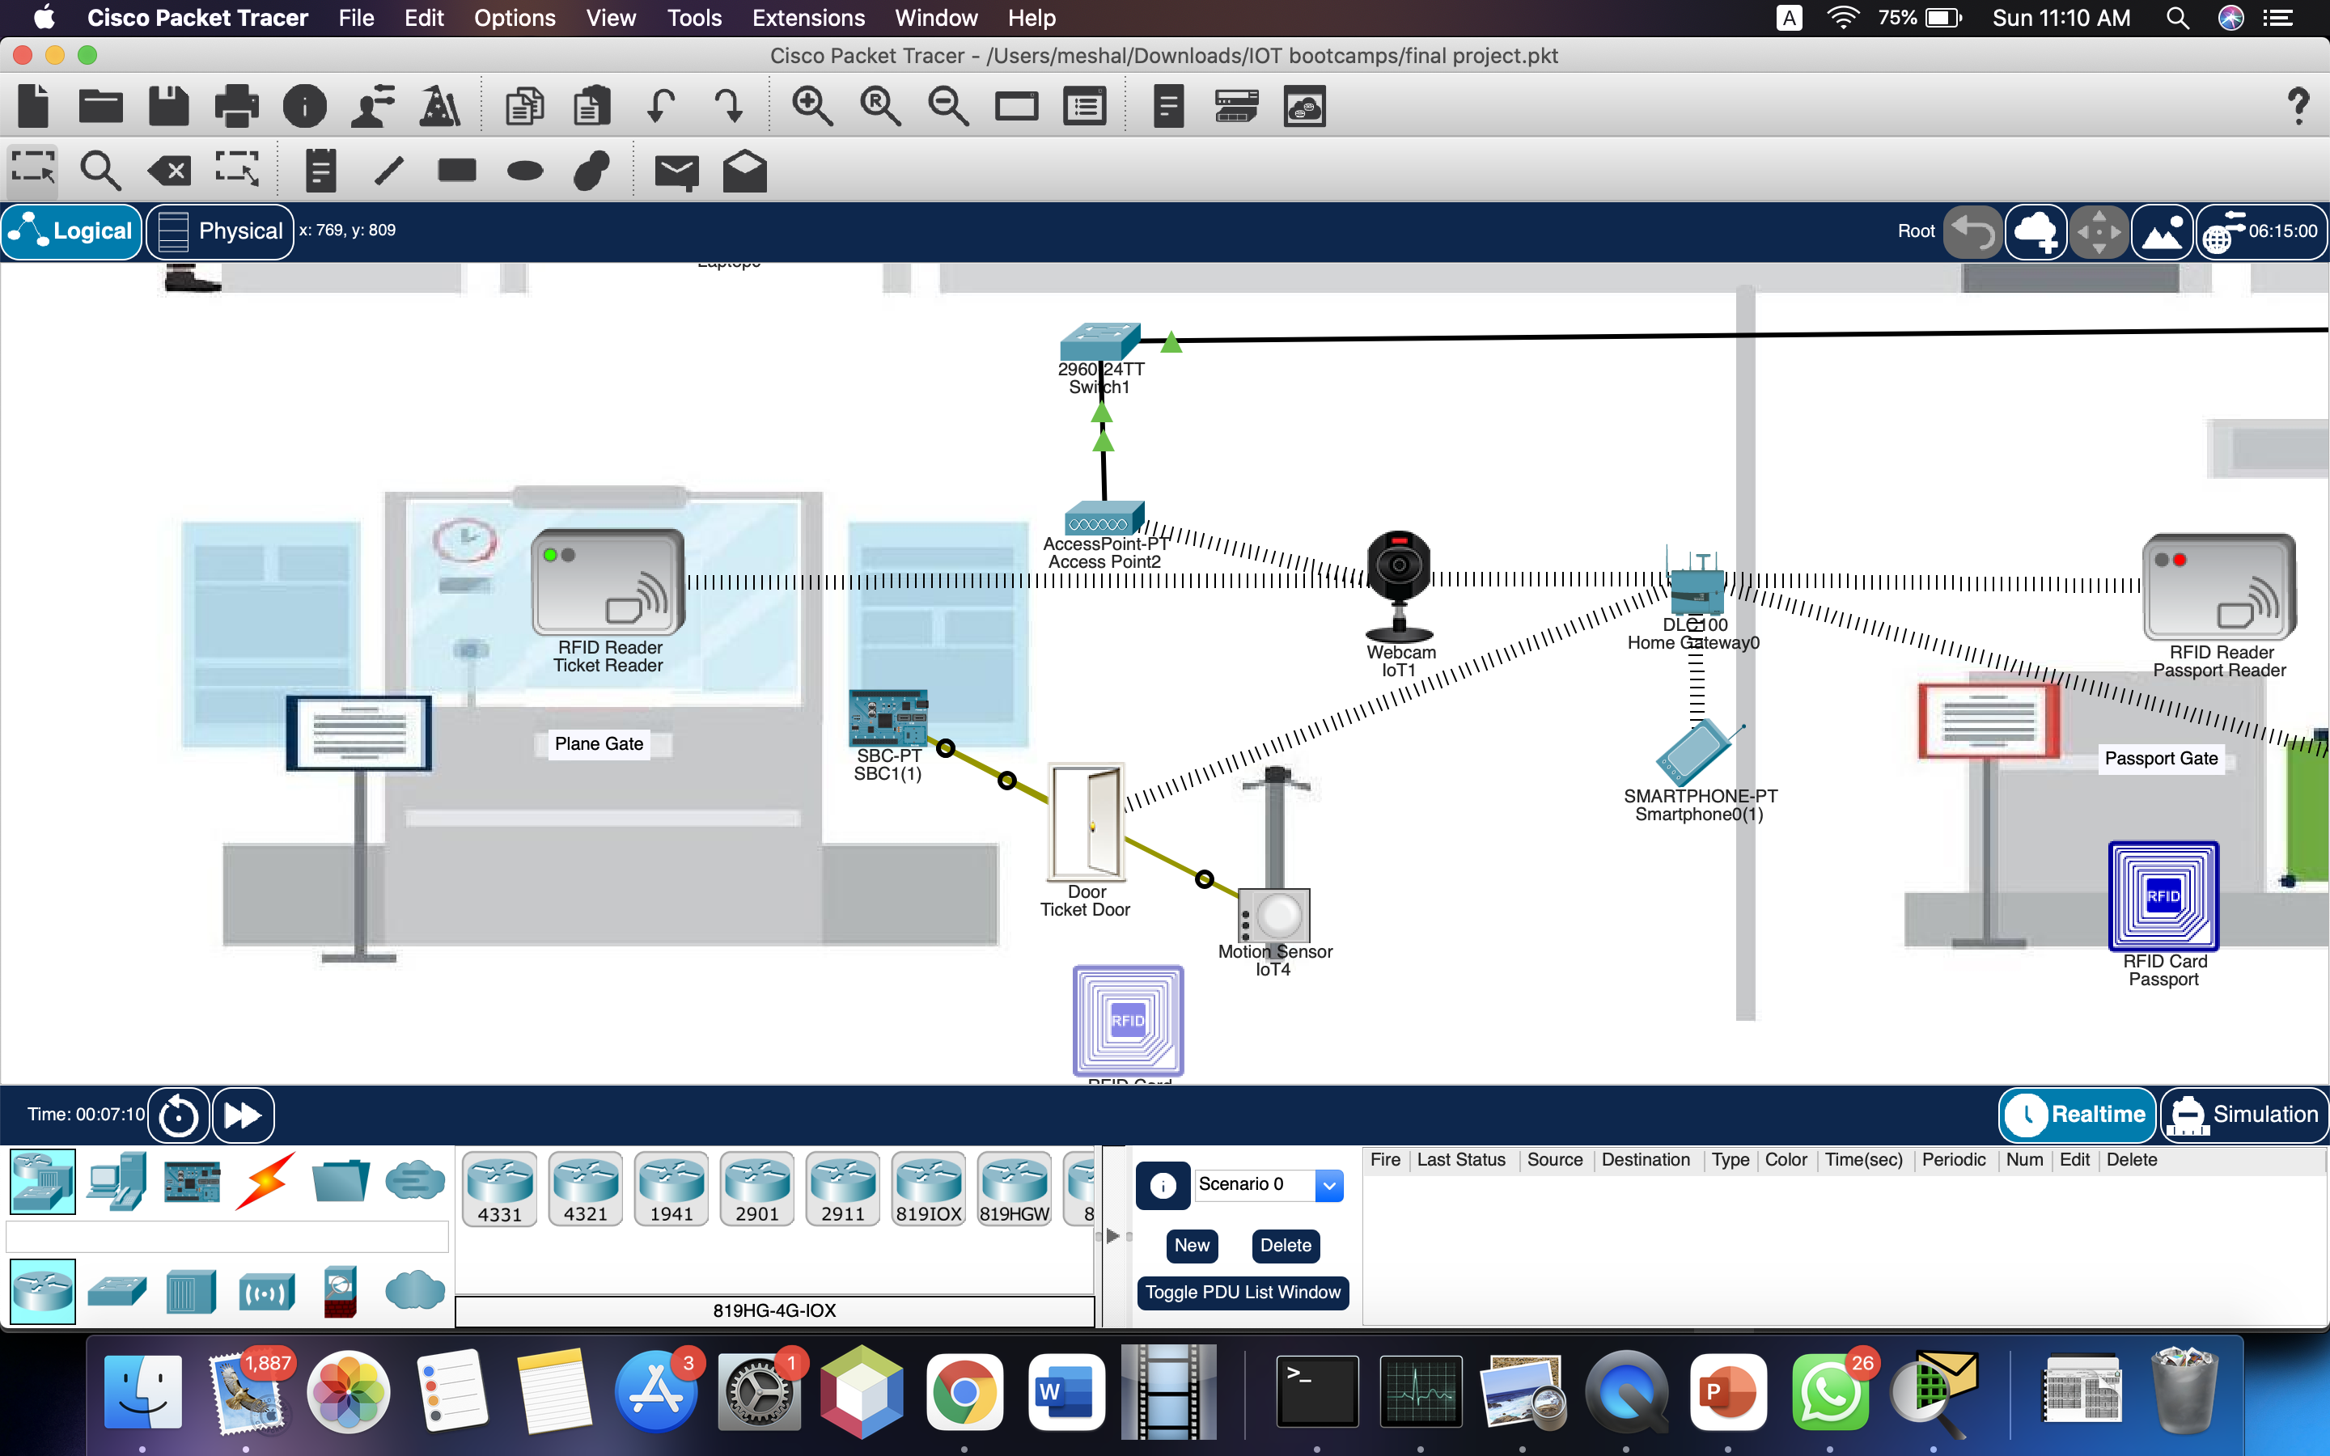
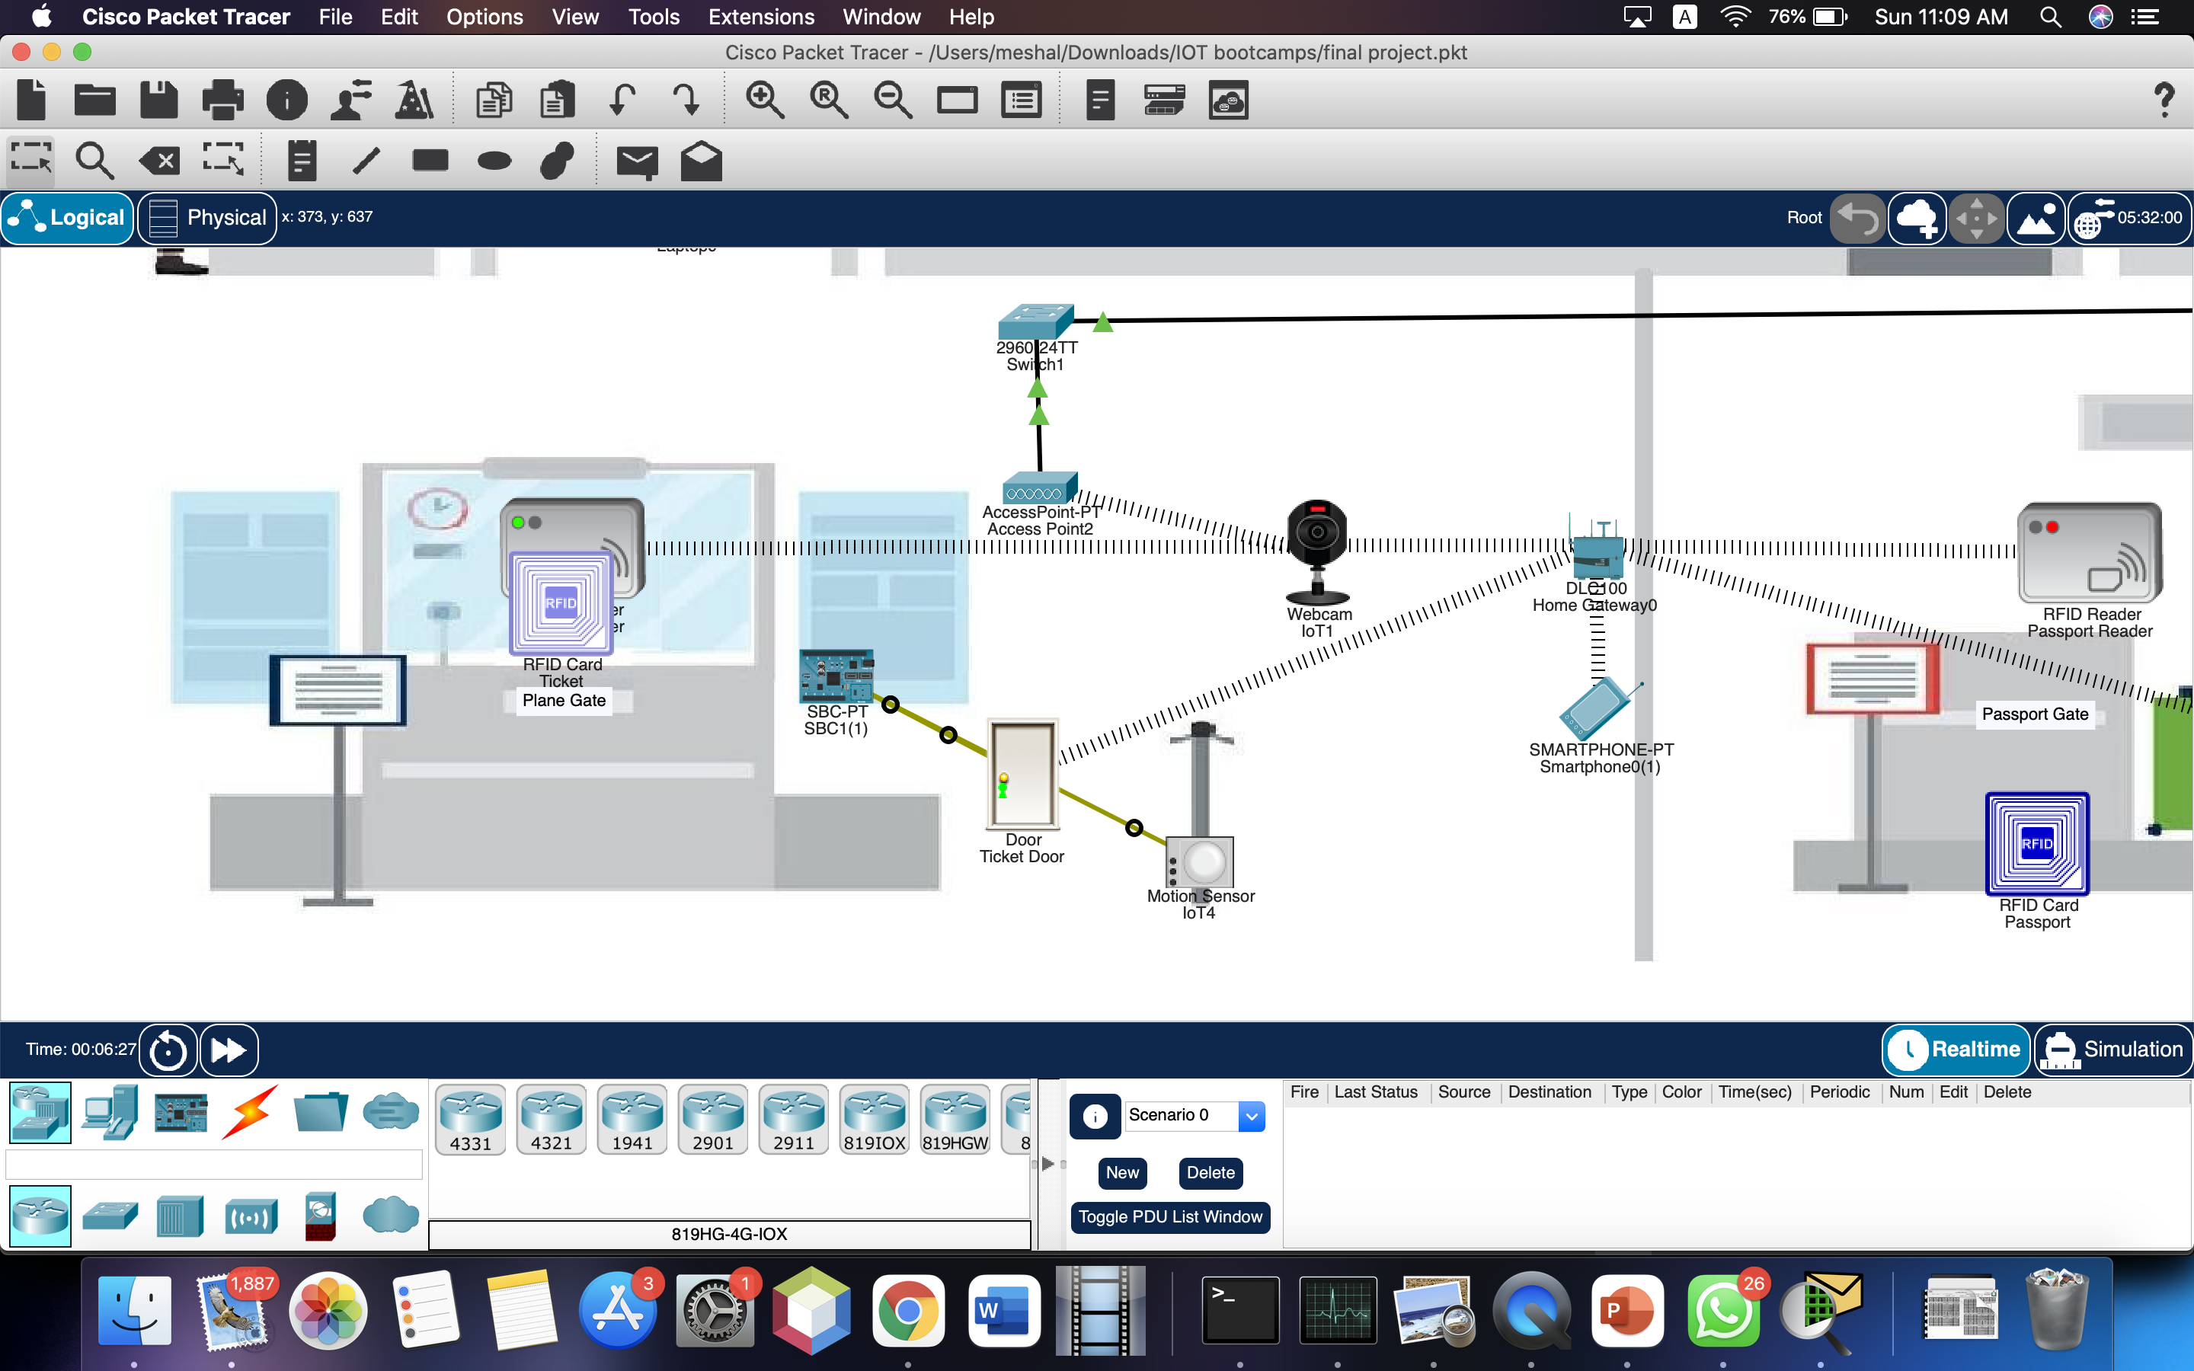
More focus
3
1
2

Slide 9
Thank You!

